Slide 1

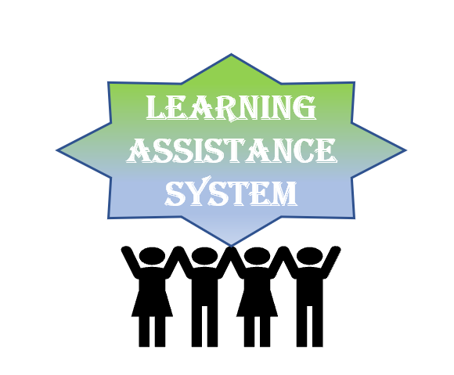
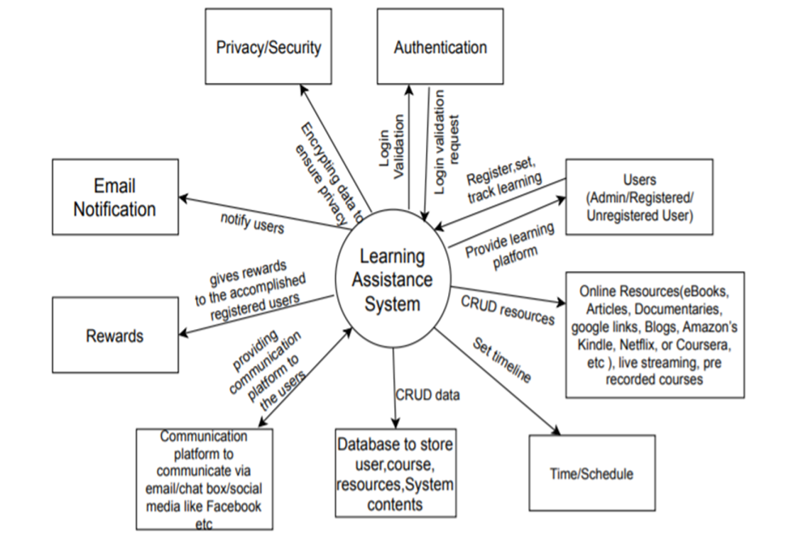
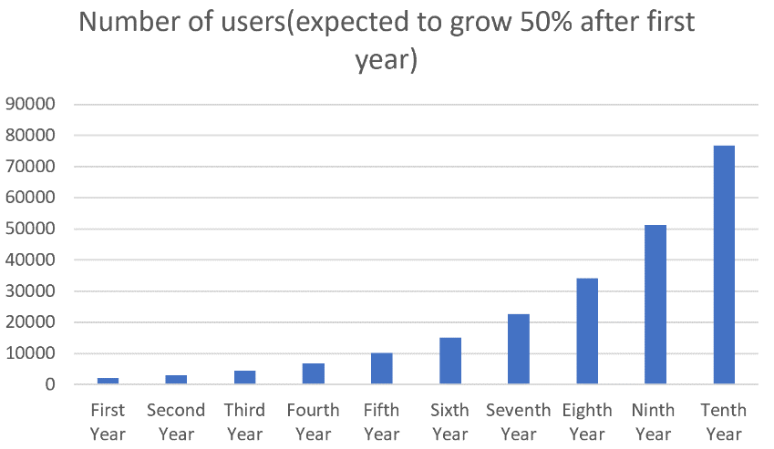
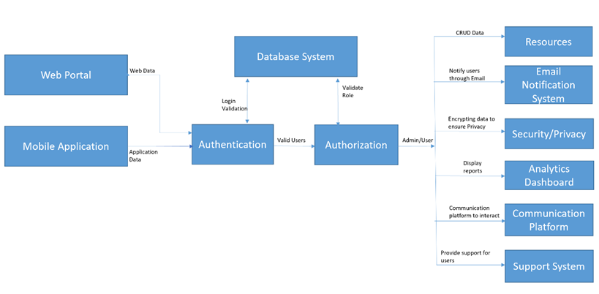






LEARNING ASSISTANCE SYSTEM
BY CODE WARRIORS
ALEESHA Reez, Meghana KANDRU & SAHANA KANNAHALLIMOLE SOMANNA
NORTHEASTERN UNIVERSITY
Abstract
Developing a flexible learning portal where a registered user can customize and track their learning depending on their areas of interest. It is a platform of all the courses and resources where the users can interact with their co-learners and get rewards to recognize their achievements. Admin can add, delete or make any modifications to the learning portal
Technology Stack
REST Architecture
Web service & App service - AWS
Languages - HTML, CSS, JavaScript, AngularJS
Database - Amazon Relational Database Service (Amazon RDS)
Notification, Support - SendGrid
Communication Platform – Amazon Chime
Authentication – Amazon Cognito
Authorization – AWS Identity Service
Security System – AWS Key Management Service
System Context diagram
Users growth
Software Architecture

